Slide 1
General Computer Knowledge
COE 201- Computer Proficiency
Mr. Ahmad AL Kawam

Slide 2
Outline
Binary Representation
Computer Parts
CPU
Memory
Primary
Secondary
Storage Capacity
I/O
Operating System

Slide 3
Binary Representation
Binary Form relies on 2 digits
0 : Zero.
1 : One.
In order to represent “M” characters we need n bits where M = 2^{n}.
Computers understand Machine Language (Strings of 0 and 1)
All characters and numbers get translated into “1”s and “0”s

Slide 4
Binary decimal
Binary to decimal
1 0 0 1 1 0 1 (binary)
= 1x2⁶+0x2⁵ +0x2⁴+1x2³ + 1x2²+ 0x2¹ +1x2⁰
= 77 (decimal)
Decimal to binary
19 (decimal)
19 = 2 x 9 + 1
9 = 2 x 4 + 1
4 = 2 x 2 + 0
2 = 2 x 1 + 0
1 = 2 x 0 + 1
19 (decimal) = 10011 (binary)

Slide 5
Computer Parts

Slide 6
CPU
Central Processing Unit
Electronic circuits that processes data.
Composed of:
Control Unit
Arithmetic/Logic Unit
The Control Unit interprets the instructions.
The Arithmetic/Logic Unit performs the logical and arithmetic operations

Slide 7
Evolution of CPUs
Generation:
8086
80x86
Pentium
Pentium MMX
Pentium II
Pentium III
Celeron
Pentium IV
Centrino
Dual Core
Core 2 Duo
Core 2 Quad
Core i3, i5, i7
…

Slide 8
Evolution of CPUs
Clock Speed:
Amount of time to execute a set of instructions.
Hz(Hertz)
1 Hz = one cycle per second.
KHz(Kilo Hertz)
1 KHz= one thousand cycles per second.
MHz(Mega Hertz)
1 MHz= one million cycles per second.
GHz(Giga Hertz):
1 GHz = one billion cycle per second.

Slide 9
Types of Memory

Slide 10
Types of Memory
Two types of memory:
Primary Storage Devices
CPU registers
Memory cache
Main Memory
Secondary Storage Devices
Hard Disks
CDs
DVDs
Capacity
Access Time
Access Time
Capacity

Slide 11
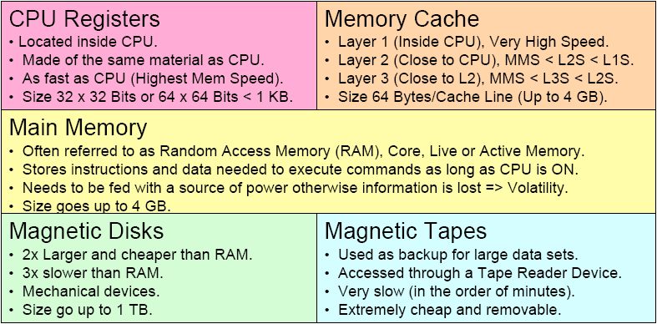
Types of Memory

Slide 12
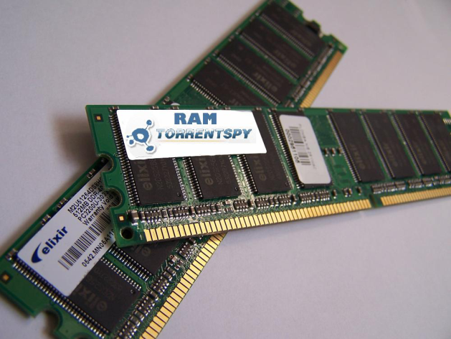
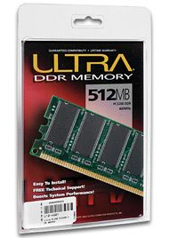
RAM
Random Access Memory
Computer’s temporary/main memory
Exists as chips on the motherboard near the CPU
Stores data or programs while they are being used
When the program or file is closed, the data
is removed from RAM
Requires power!
The amount of RAM you have on your computer is crucial in determining how many programs can be opened (running) and how much data is available for each program

Slide 13
Secondary Storage Devices
Auxiliary storage devices
used to store instructions and data when they are not being used in memory.
Common types are:
Hard Disks
Consists of one or more rigid metal platters coated with a metal oxide material that allows data to be recorded magnetically on the surface of the platters.
CDs
DVDs

Slide 14
HD Structure

Slide 15
HD Structure (continued)

Slide 16
Storage Capacities
Main unit is Binary Digit or Bit.
1 Byte = 8 Bits.
1 KB = 1 Kilo Byte = 2^10 Bytes = 1024 Bytes
1 MB = 1 Mega Byte = 2^20 Bytes = 1024 KB
1 GB = 1 Giga Byte = 2^30 Bytes = 1024 MB
1 TB = 1 Tera Byte = 2^40 Bytes = 1024 GB

Slide 17
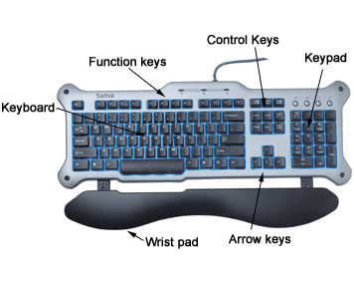
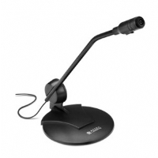
I/O: Input Devices
Hardware device that sends information to the computer.
keyboard, mouse,
digital camera, scanner
Microphone etc

Slide 18
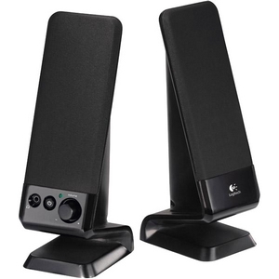
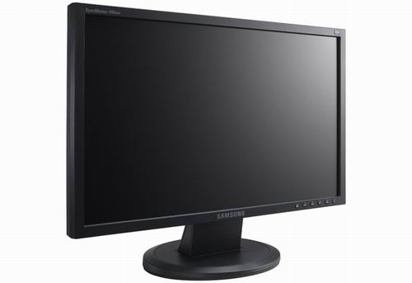
I/O: Output Devices
Hardware device that provides feedback to the user.
Screens/display devices
Printers
Speakers

Slide 19
Operating System
First program that starts when PC is ON.
Perform hardware checks.
Translator between user and hardware.
User issues commands in Human Language.
OS translates commands to Machine Language.
Provides user with easy-to-use interface.
Provides user with File Management Capabilities.
Supports other software accesses of HW.

Slide 20
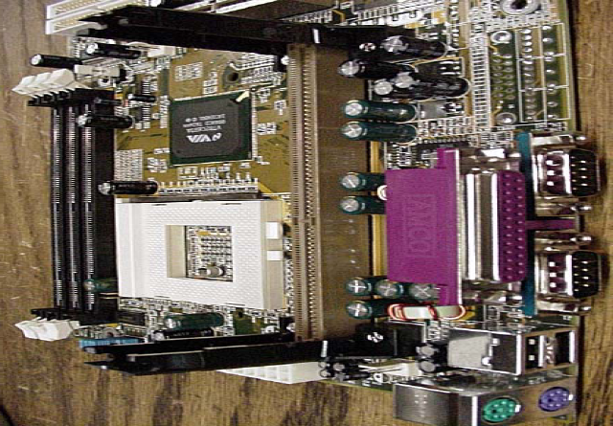
Mother Board

